Slide 1
Lesson 2
The Neutral Environment
Drag
Sputtering
Atomic Oxygen
Spacecraft Glow
THE EMPTY, VAST AND WANDERING AIR
Shakespeare

Slide 2
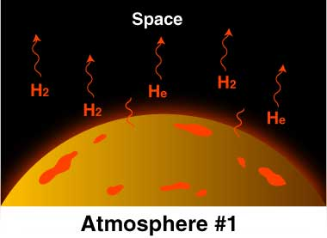
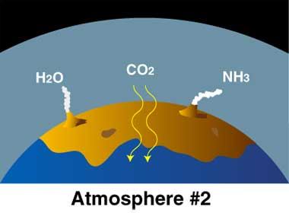
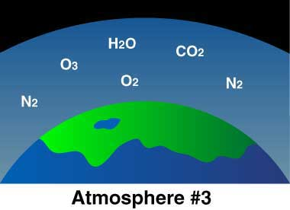
FORMATION OF THE EARTH’S ATMOSPHERE

Slide 3
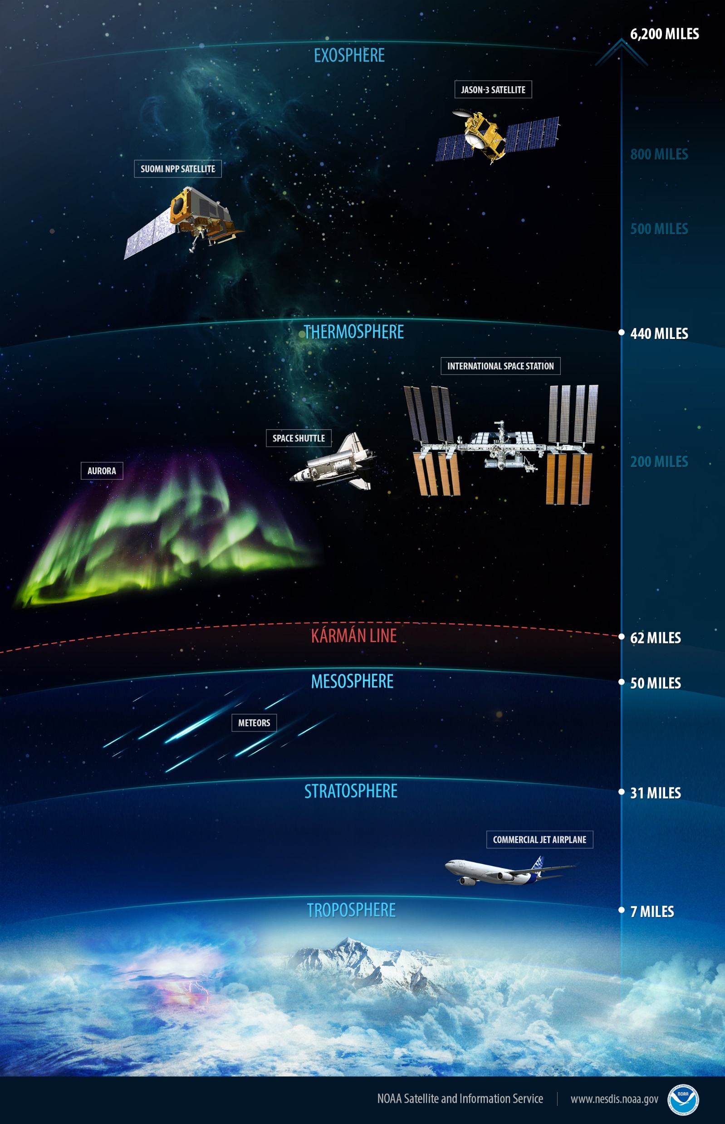



AERONOMY
The ionosphere is a layer of charged particles in Earth’s atmosphere that extends from about 50 to 360 miles above the surface of Earth. Processes in the ionosphere also create bright swaths of color in the sky, known as airglow.
Space Begins

Slide 9
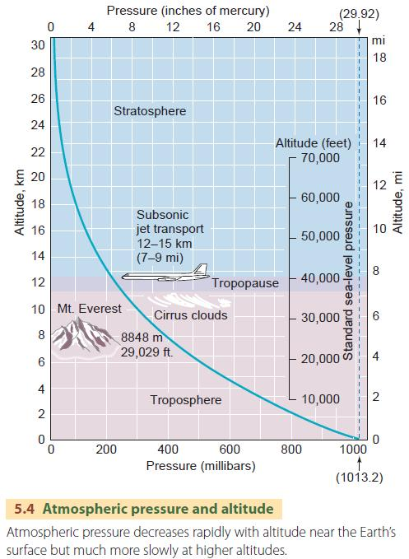

PRESSURE VARIES WITH ALTITUDE
$P\left(h\right)= P_{o}e^{(\frac{h_{o}−h}{H})}$ < 100 km
H = scale height = $\frac{kT}{mg}$
h = altitude (m)
$$P_{o }=Pressure at sea level \left(\frac{N}{m^{2}}\right)$$
$=101,325\left(\frac{N}{m^{2}}\right)$ or Pa
$=1013.25 mbars$
= 14.69 psi

Slide 10
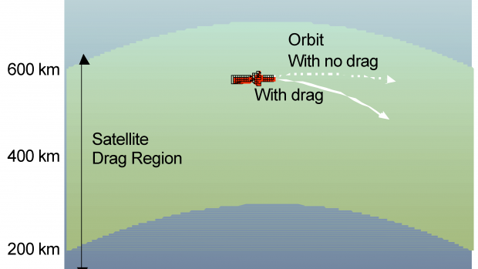
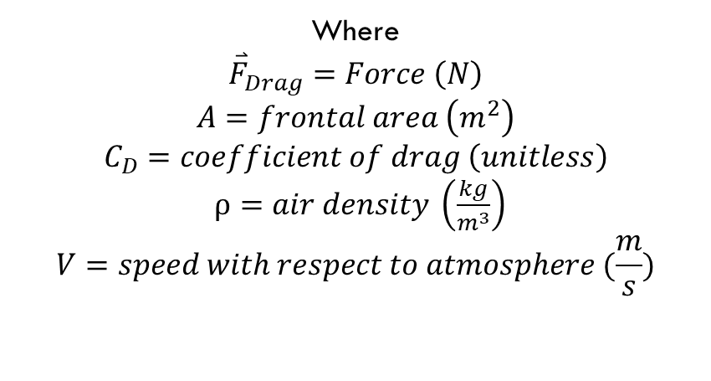
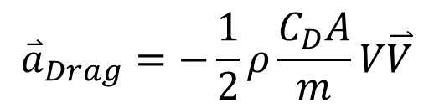
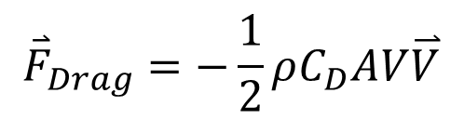
AERODYNAMIC FORCES
$${\overset{⃑}{a}}_{Drag}=−\frac{1}{2}ρ\frac{C_{D}A}{m}V\overset{⃑}{V}$$
$${\overset{⃑}{F}}_{Drag}=−\frac{1}{2}ρC_{D}AV\overset{⃑}{V}$$
Where
$${\overset{⃑}{F}}_{Drag}=Force \left(N\right)$$
$$A=frontal area \left(m^{2}\right)$$
$$C_{D}=coefficient of drag \left(unitless\right)$$
$ρ=air density \left(\frac{kg}{m^{3}}\right)$
$$V=speed with respect to atmosphere (\frac{m}{s})$$

Slide 11
Atmospheric Neutral Environment: Aerodynamic Drag
Density, ρ, is highly dependent on solar activity and very difficult to model and predict (changes by a factor of 10 to 30 from solar minimum to solar maximum at altitudes from 400 km to 700 km)
Solar
Minimum
Solar
Maximum
ALSO
Chemical composition changes
H varies with temperature
Etc!
200
150
Numbers of Sunspots
100
50
CYCLE
21
CYCLE
22
CYCLE
23
CYCLE
24
CYCLE
25
1978
1986
1994
2002
2010
2018
2026
The Solar Cycle - www.sunspotcycle.com
Notes:
This is the dominant neutral environment effect due to the high velocities involved
11-year cycle
Atmospheric density depends on solar cycle (see next page)
(1.9 to 2.6)
Shape and mass distribution of the spacecraft (bullets vs balloons)
Predictions of a future maximum's timing and strength are very difficult; predictions vary widely. There was a solar maximum in 2000. In 2006 NASA initially expected a solar maximum in 2010 or 2011, and thought that it could be the strongest since 1958.^{[3]} However, the solar maximum was not declared to have occurred until 2014, and even then was ranked among the weakest on record.^{[4]}

Slide 12
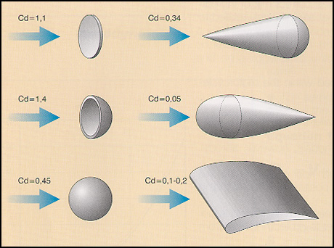
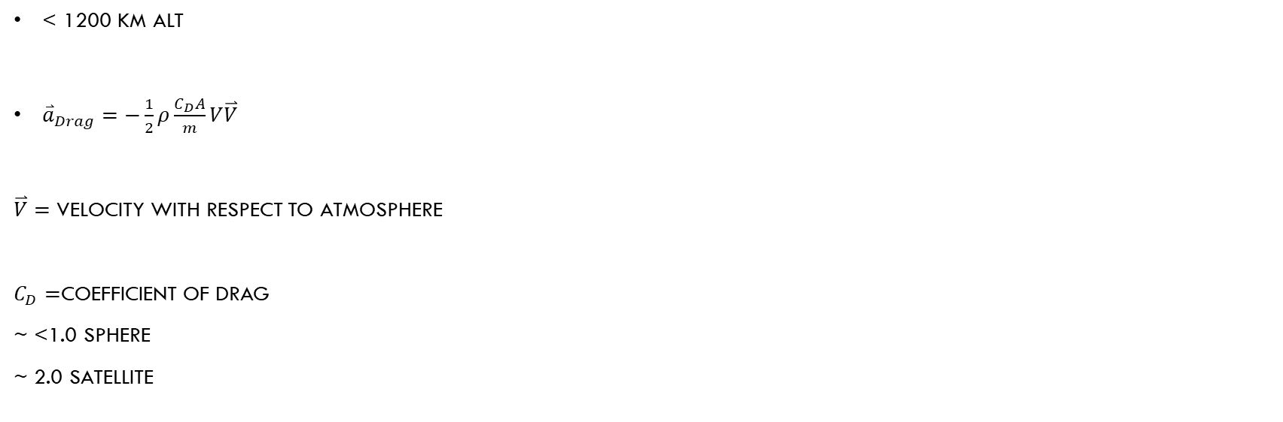
DRAG
< 1200 KM ALT
${\overset{⃑}{a}}_{Drag}=−\frac{1}{2}ρ\frac{C_{D}A}{m}V\overset{⃑}{V}$
$\overset{⃑}{V}=$ velocity with respect to atmosphere
$C_{D}=$coefficient of drag
~ <1.0 sphere
~ 2.0 satellite

Slide 13
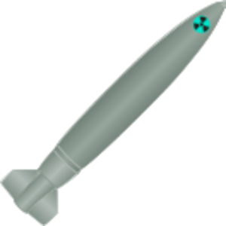
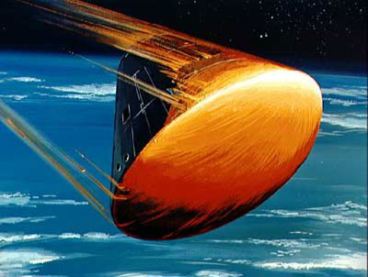


AERODYNAMIC FORCES
High BC
$${\overset{⃑}{a}}_{Drag}=−\frac{1}{2}ρ\frac{C_{D}A}{m}V\overset{⃑}{V}$$
$$\frac{C_{D}A}{m}≡\frac{1}{BC}$$
Low BC

Slide 14
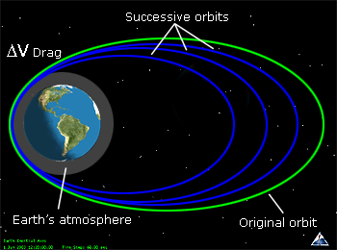
PERTURBATIONS
The swelling of Earth’s upper atmosphere during geomagnetic storms can alter the orbits of satellites, bringing them lower and lower.
DRAG EFFECTS

Slide 15
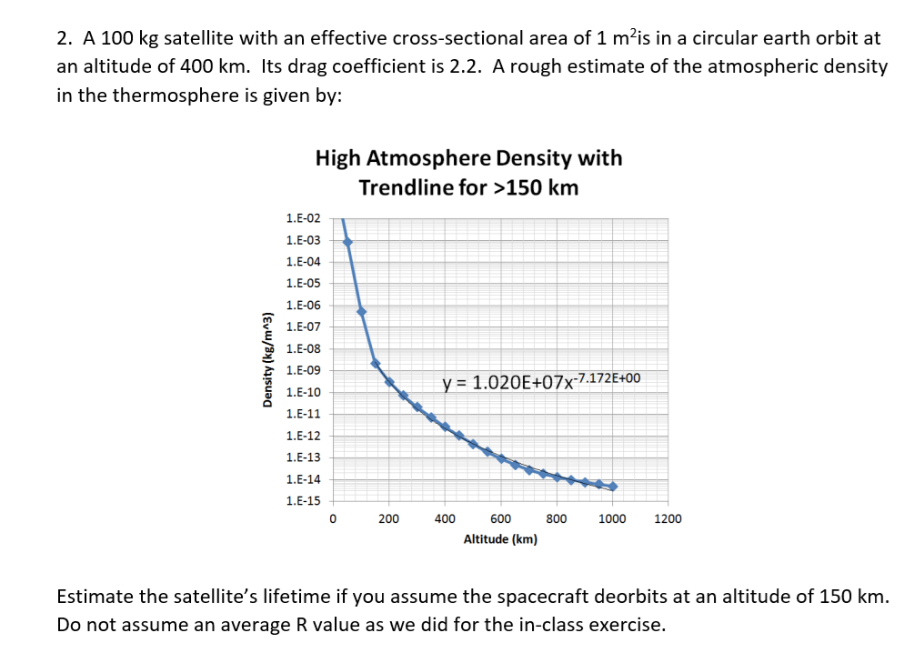

Slide 22
HOMEWORK PROBLEM 3
3. How much drag makeup fuel is needed for the spacecraft in problem 2 to maintain its original orbit for one year? Assume average solar cycle conditions and monopropellant fuel with an I_{sp} = 200 seconds. Use your model from problem 2 to find the atmospheric density.

Slide 23
REFERENCES
MAMcIntosh. (2016, December 14). Revolutions in Understanding the Ionosphere, Earth's Interface to Space. Brewminate. https://brewminate.com/revolutions-in-understanding-the-ionosphere-earths-interface-to-space/
News. NOAA National Environmental Satellite, Data, and Information Service (NESDIS). (2016, February 22). https://www.nesdis.noaa.gov/content/peeling-back-layers-atmosphere

